Slide 1
R Shiny Tips and Tricks: An App Store Project Demo
Author: Bohdan Metenko
Thursday, August 15th, 2019 < > 6:00pm
PhillyR Meetup
Hosted by Slalom Consulting,
100 N 18th St #2000, Philadelphia, PA

Slide 2
Talk Outline
0. Intro to Shiny
App Overview
CSS styling and options.
Mobile considerations and splitting up plots.
Smaller Tips
Travis CI and requirements. (Continuous Deployment and Integration.)

Slide 3

Introduction to Shiny
#0
Shiny is an R package that helps build web-based applet-like functionality without the need for JavaScript, CSS, or HTML knowledge. (It can help though.)
Enables interactivity for both you and the end-user.
Easily web-publishable.
Maintained by RStudio.
Is the basis for packages like ggthemeassist and esquisse.
Example: Next slide.

Slide 4
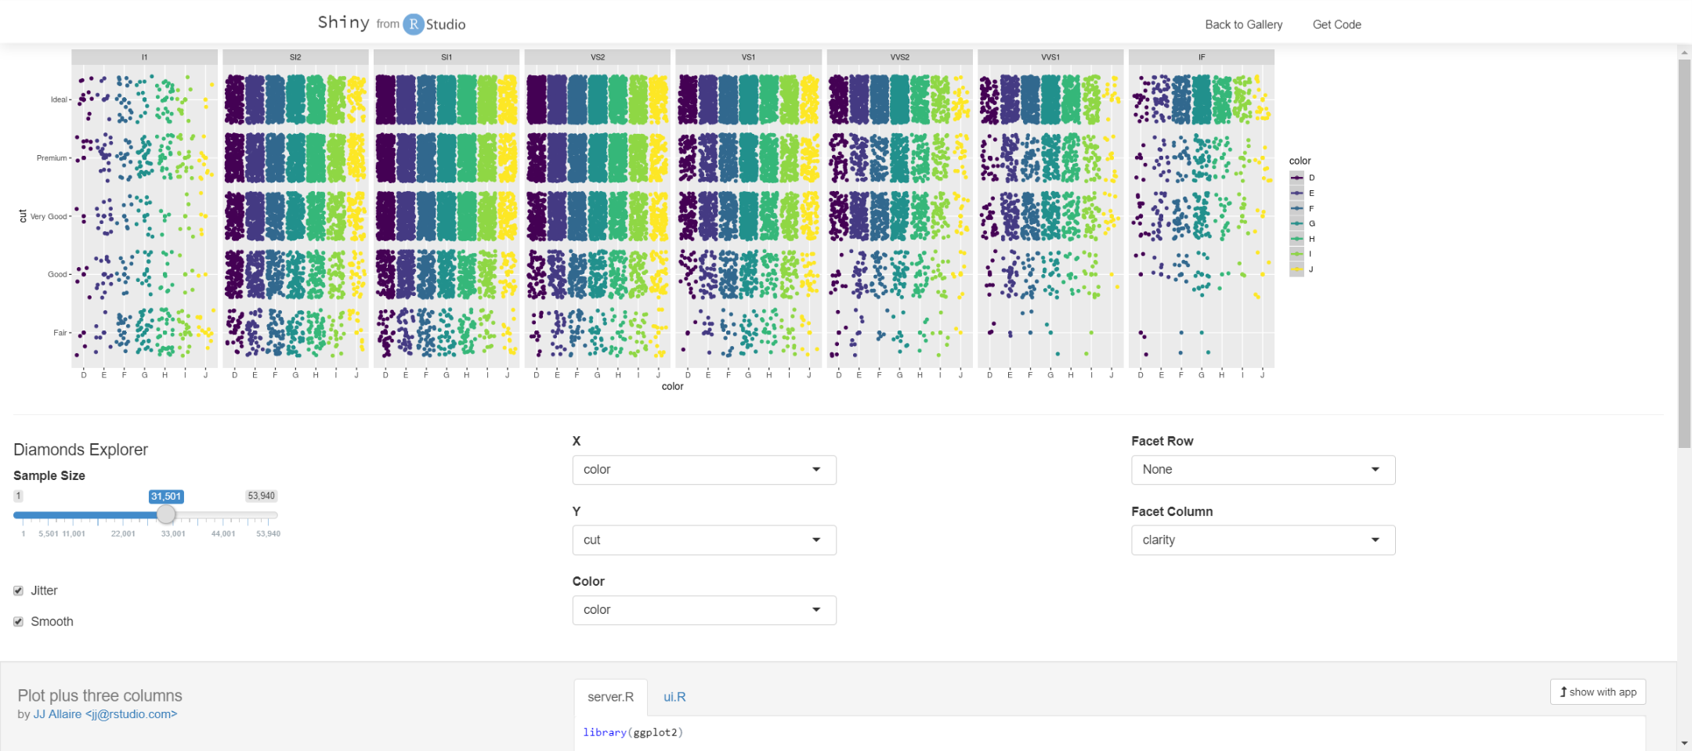
Example: https://shiny.rstudio.com/gallery/plot-plus-three-columns.html

Slide 5
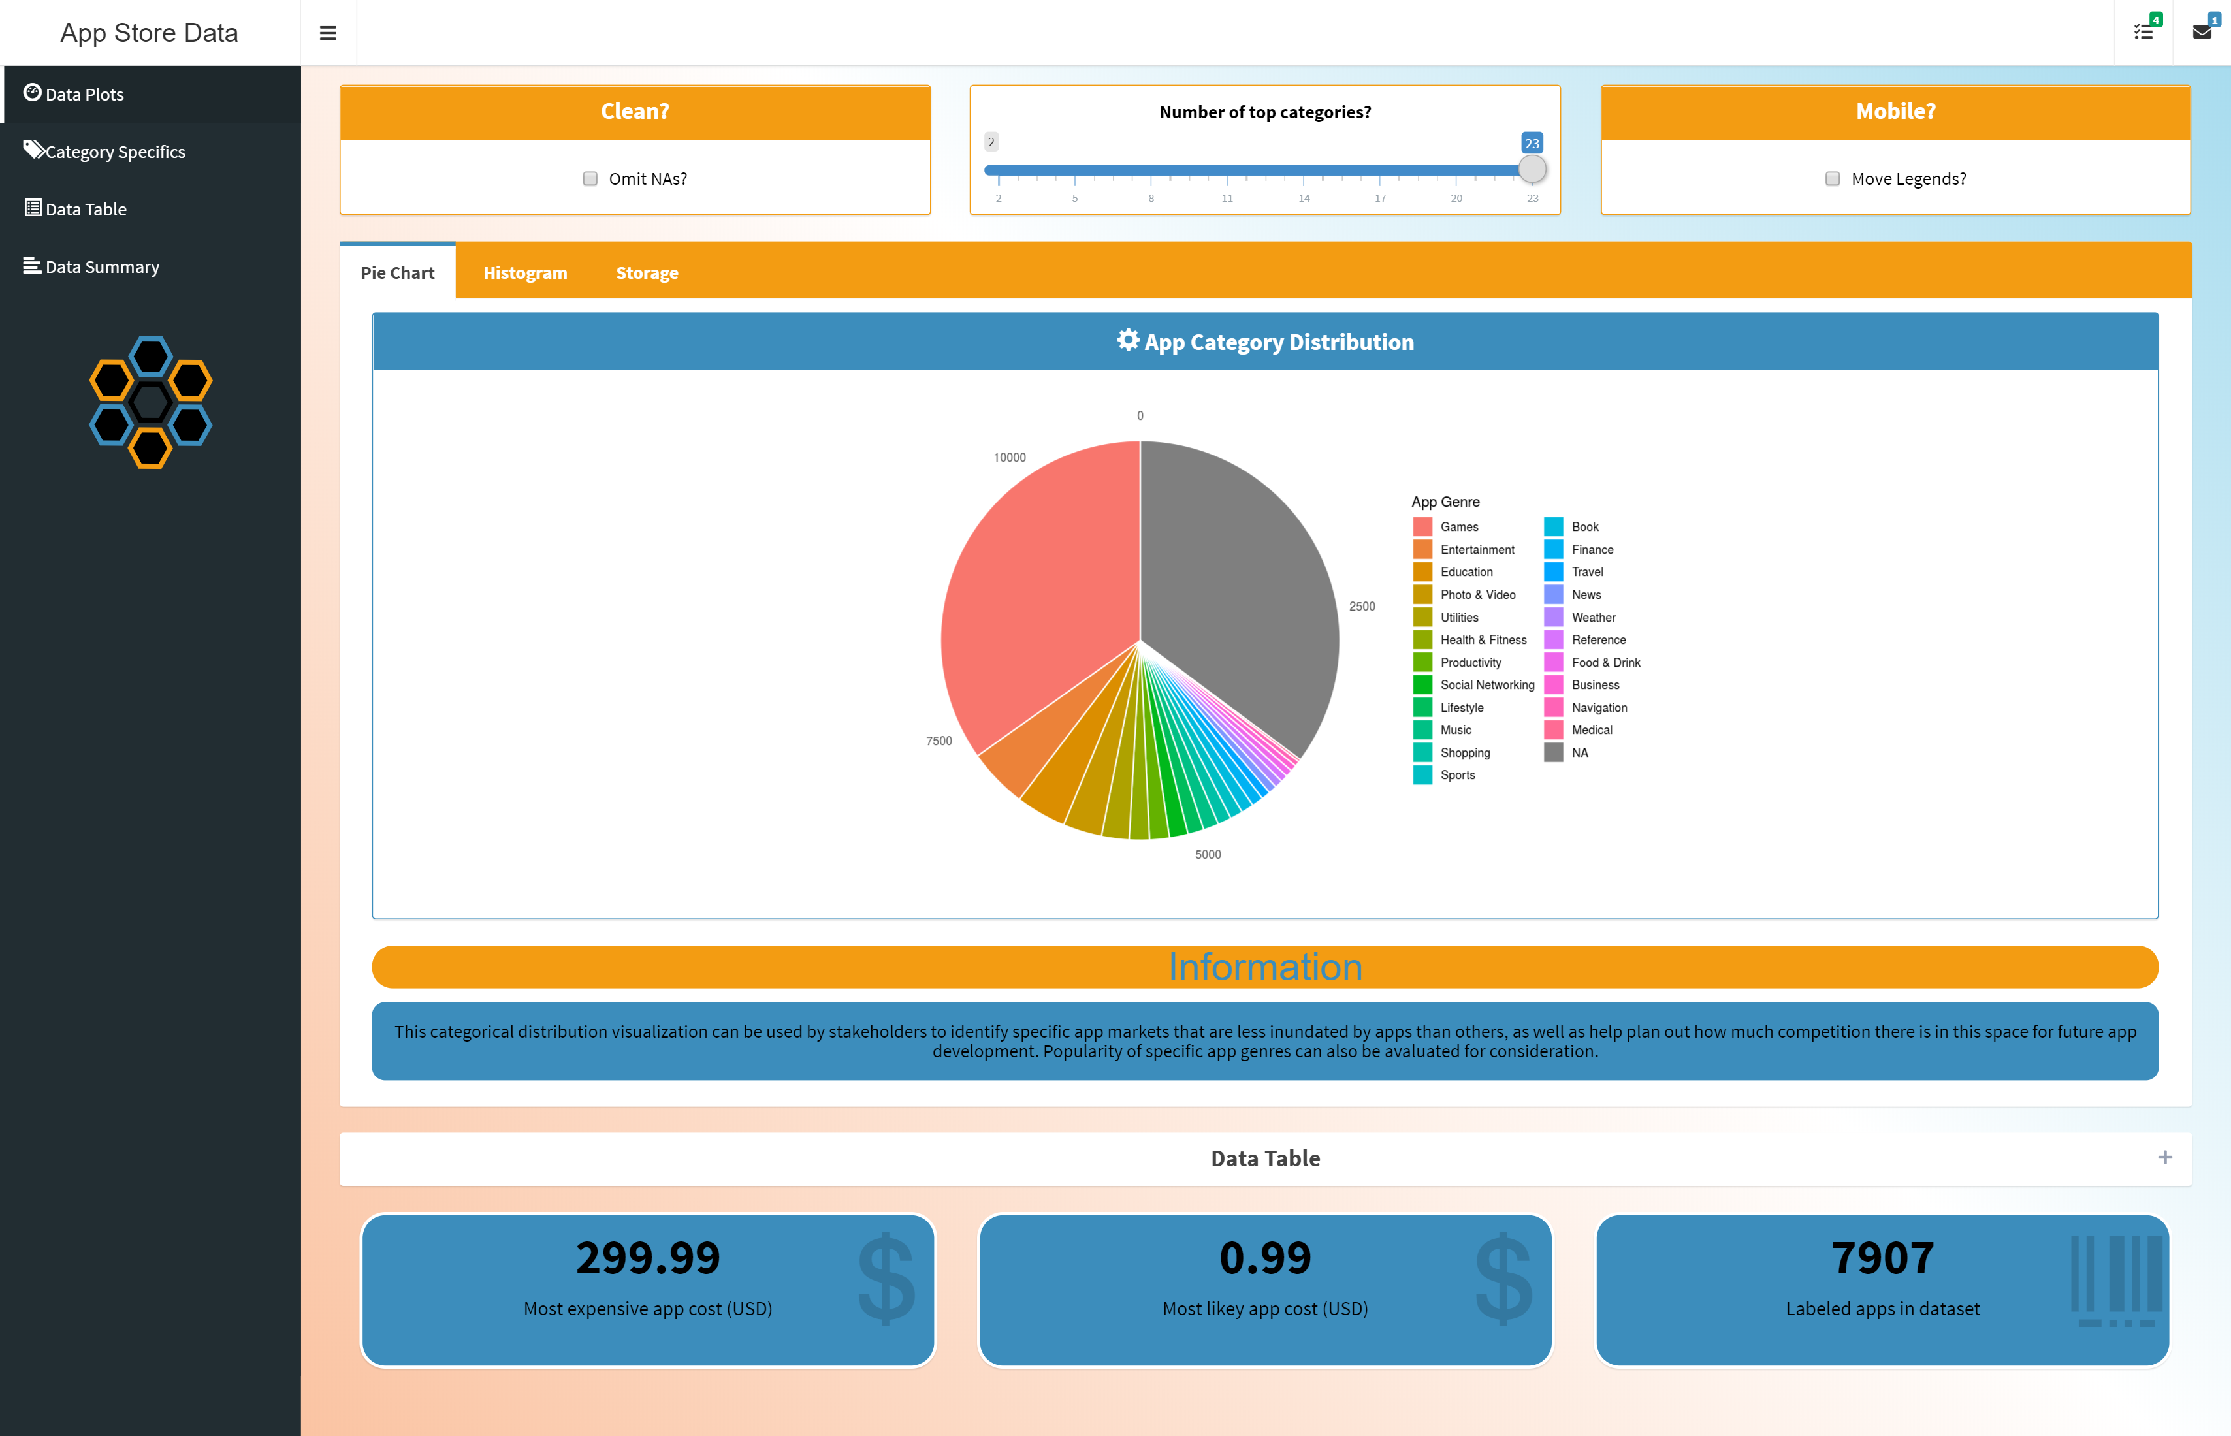
My Current App State
Code available at
https://www.github.com/bmetenko/RShinyAppStore
(Note: please run package_check.R before running the app from RStudio on your machine.)
A Live version is published on
https://bmetenko.shinyapps.io/RShinyAppStore/
(Limited to the Free tier, so please everyone don’t jump on there at once.)
Purpose: Visualization and Presentation of
Apple App Store Data from 2017
(App Sizes, App Ratings, App Genre)

Slide 6
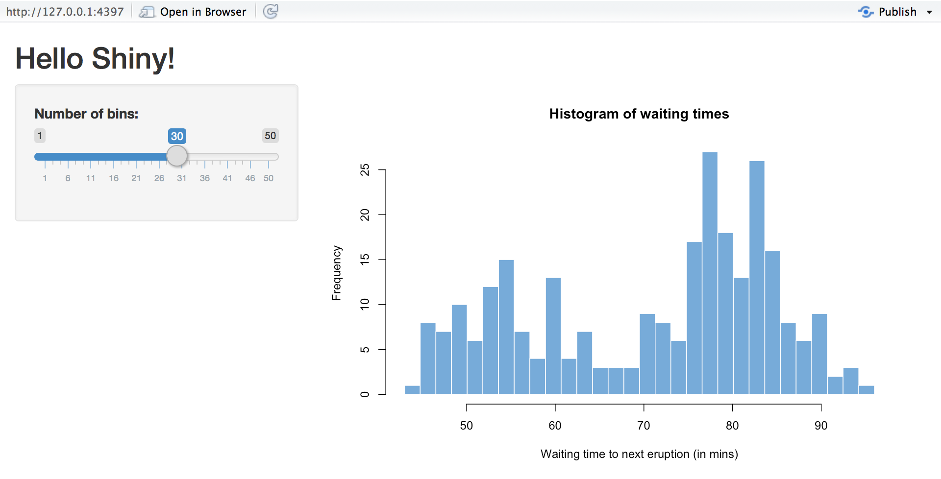
Tips and Tricks #1: CSS styling
#1
Normal Shiny is plain.
(Kind of like this PowerPoint)
Overriding CSS can change that.
It helps you change colors, add hover over effects, create background gradients and the like.
A little bit of CSS knowhow is useful, but it is very easy for anyone to pick up.

Slide 7
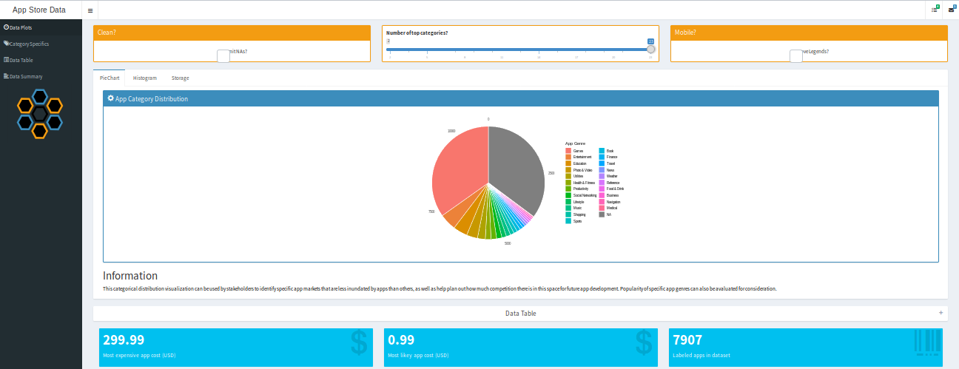
With and Without
Without CSS
Caveat: Also using shinydashboard library for page theme.

Slide 8
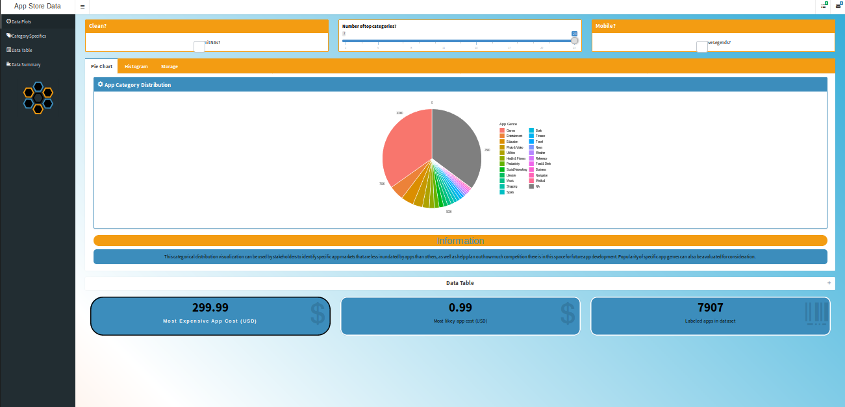
With CSS

Slide 9
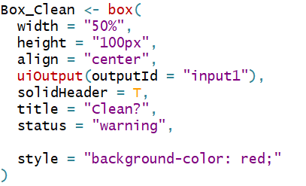
Tips and Tricks #1 | CSS styling
In Practice:
Multiple choices for CSS:
Inside specific elements of the app
EPOC – Tailwind CSS
In the header element of your main app body.
EPOC
Personal and separate stylesheet and reference.
EPOC
External Specialized Stylesheet

Slide 10
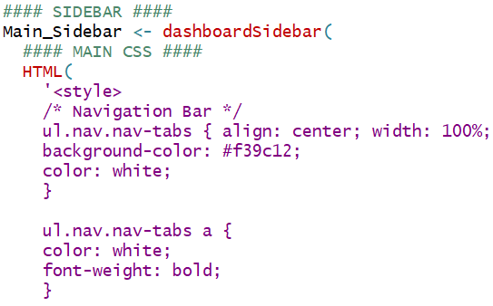
Tips and Tricks #1 | CSS styling
In Practice:
Multiple choices for CSS:
Inside specific elements of the app
In the header element of your main app body.
EPOC
Personal and seperate stylesheet and reference.
EPOC
External Specialized Stylesheet
EPOC – Tailwind CSS
Example picture of code. (EPOC)

Slide 11
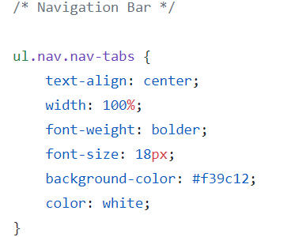
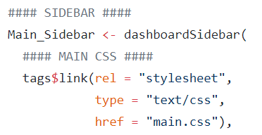
Tips and Tricks #1 | CSS styling
In Practice:
Multiple choices for CSS:
Inside specific elements of the app
Example picture of code. (EPOC)
In the header element of your main app body.
Personal and separate stylesheet and reference. [www/main.css]
EPOC
External Specialized Stylesheet
EPOC – Tailwind CSS
EPOC

Slide 12
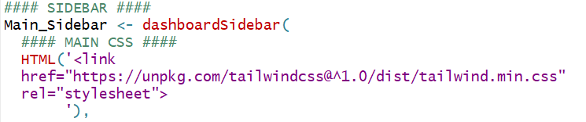
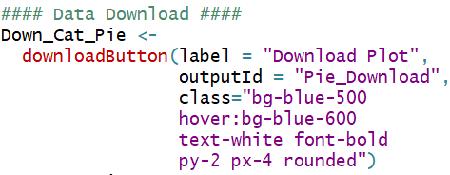
Tips and Tricks #1 | CSS styling
In Practice:
Multiple choices for CSS:
External Specialized/Simplified Stylesheet
Example picture of code. (EPOC)
In the header element of your main app body.
EPOC
Personal and separate stylesheet and reference.
EPOC
Tailwind CSS using class assignment
Inside specific elements of the app
More info at https://tailwindcss.com/
And https://nerdcave.com/tailwind-cheat-sheet

Slide 13
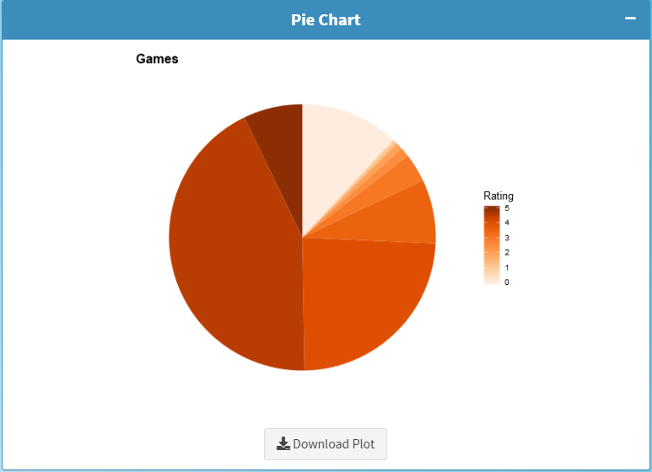
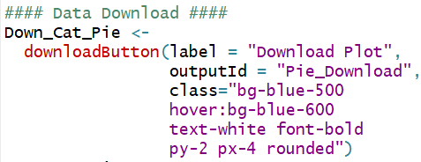
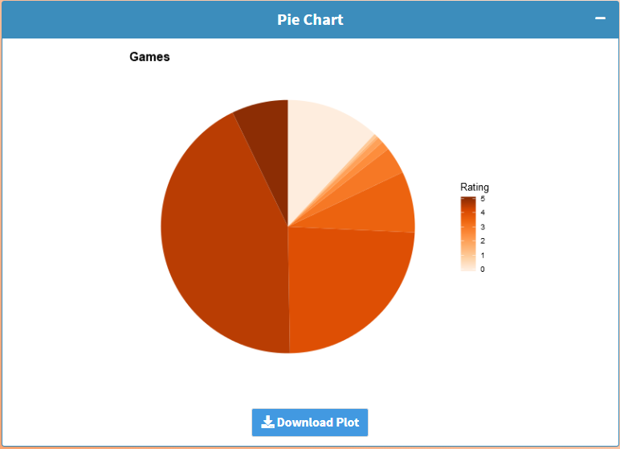
Caveats:
Loading this stylesheet will override any default shiny CSS properties for elements like a, h1 to h5 tags.
May also take longer to load.

Slide 14
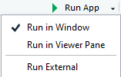
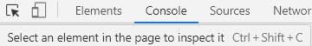
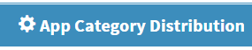
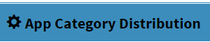
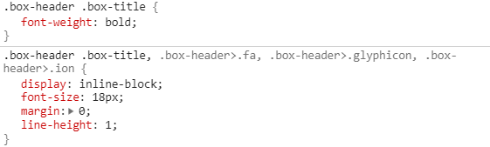
Finding the class tag you want to assign CSS properties to.
#1
Add something new to your CSS file.
.box-header .box-title:hover {
color: black;
padding: 0.1em;
}
Run your shiny app externally
Press F12
Click
and select the element
Or
Right click your element and click inspect

Slide 15
Finding the class tag you want to assign CSS properties to.
#1
Add something new to your CSS file.
.box-header .box-title:hover {
color: black;
padding: 0.1em;
}
Run your shiny app externally
Press F12
Click
and select the element
Or
Right click your element and click inspect

Slide 16
Important notes
#1
If you change some color or property that is locked in by the stylesheet provided by shiny, it may be useful to override it with:
color: blue!important;
Another important point is that once you change and apply styles to one class of objects, they will all have those styles.
If this is not useful:
Make a new class for the element you care about and style it using .new-class { }
Adding JavaScript, jQuery, and HTML follows some of the rules mentioned, but would deserve their own talk and are worth learning more about.
CSS is just more manageable for most people.

Slide 17
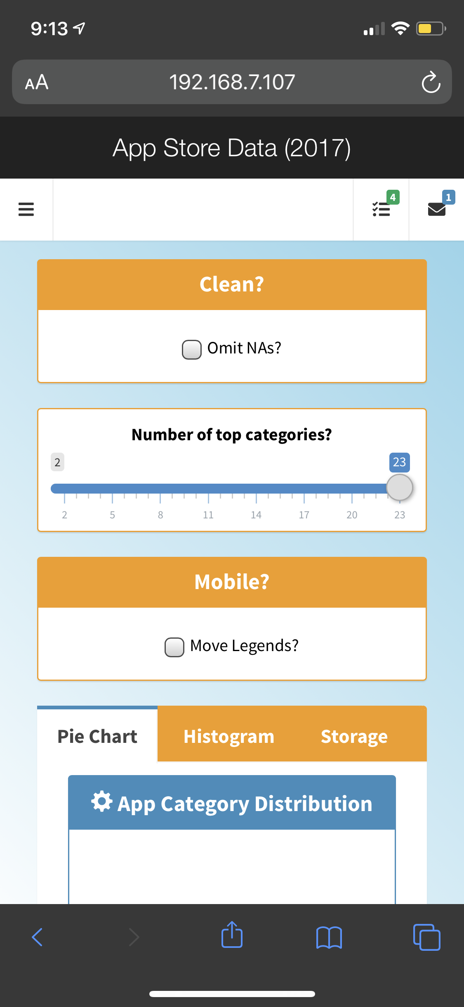
Remember your cell phone?
#2
Your shiny applications can be published to online services like shinyapps.io where they can be accessed from most devices by anyone.
To test how they will look on other machines, you can run your shiny app in an R session using
Prereq = { library(shiny) }
runApp(host="0.0.0.0", port=5050)
You’ll have to check for your IP address using ipconfig or ifconfig then connect to the app via a webpage URL such as 192.168.1.107:5050
If the device you are using is connected to the same network, then there shouldn’t be any issues.

Slide 18
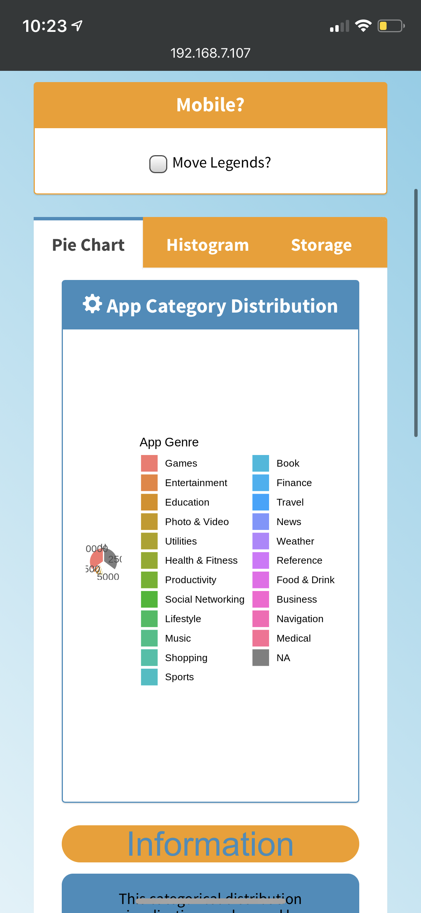
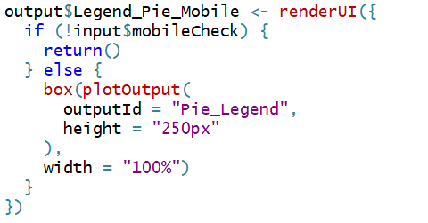
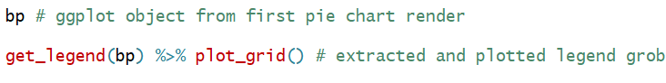
This helps us find interesting problems…
#2
Solution >
Such as incorrect plot scaling.
But the fix leads us into two more shiny tips:
renderUI (on the fly) based on conditions
Toggle a new plot to be rendered based on mobile checkbox state.
Said plot only contains the legend. (cowplot library required.)
Problem >

Slide 19

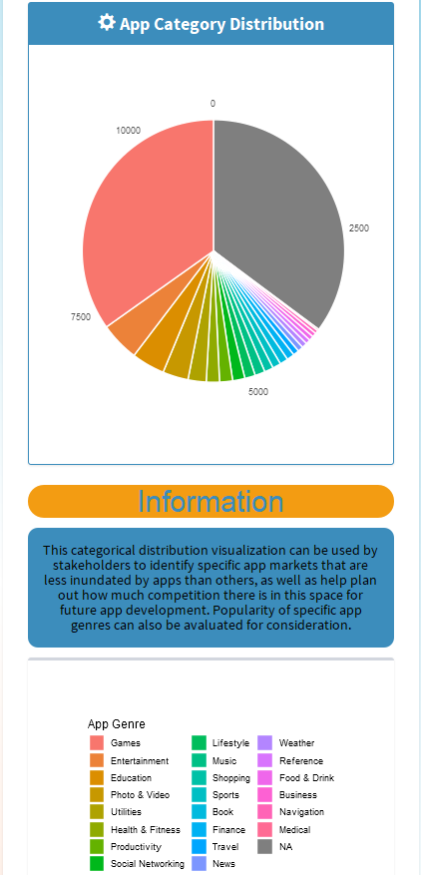
#2
VS.

Slide 20
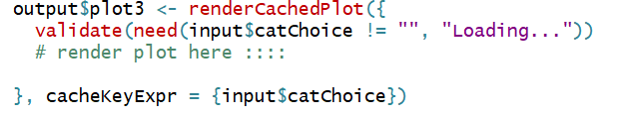
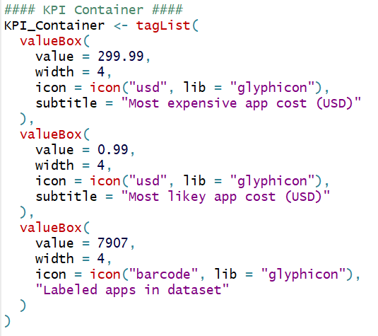
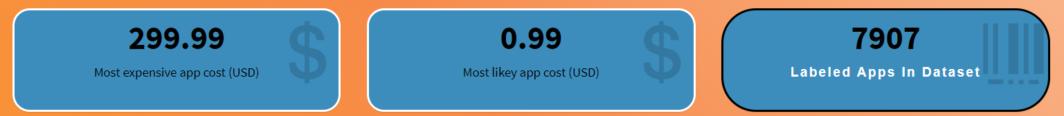
Smaller tips
#3
Plot caching.
Using renderCachedPlot(…) instead of renderPlot(…)
Specifying hashable elements for caching based on list of inputs
https://shiny.rstudio.com/articles/plot-caching.html
Taglists to plot multiple UI elements.
Highlighting information using KPI boxes.
Pivot table and scrollability.
[[ShinyWidgets]]?
Maintaining a color theme.

Slide 21
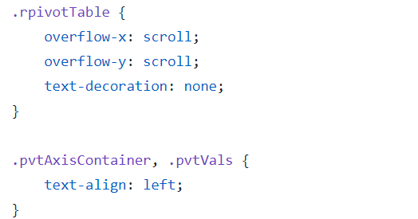

Smaller tips
#3
Plot caching.
Using renderCachedPlot(…) instead of renderPlot(…)
Specifying hashable elements for caching based on list of inputs
https://shiny.rstudio.com/articles/plot-caching.html
Taglists to plot multiple UI elements.
Highlighting information using KPI boxes.
Pivot table and scrollability. (more niche)
Without these modifications, interactions with the rPivotTable tables overflow beyond page borders, and text isn’t visible in the main viewport.
Maintaining a color theme. (less niche)

Slide 22
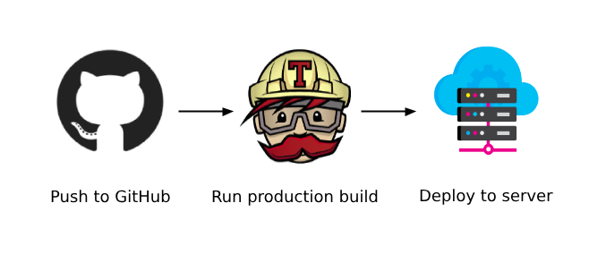

Travis CI (Continuous Deployment and Integration)
#4
Basic requirements:
YAML configuration file
Deploy script
Environmental Variables
Before starting, make sure to hook up your GitHub account with your Travis CI account and your shinyapps.io account.
https://travis-ci.org

Slide 23
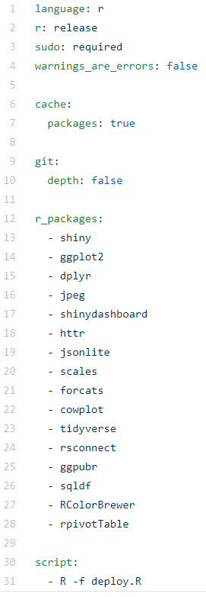
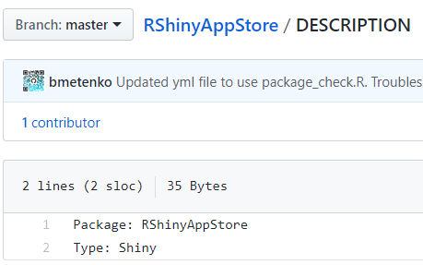
.travis.yml file
#4
Simple file specifying to Travis-CI what to install.
R version and package versions can be specified.
Last entry in the list is the shell deploy script to upload and re-deploy the shiny app.
Another Requirement:
A DESCRIPTION file:

Slide 24
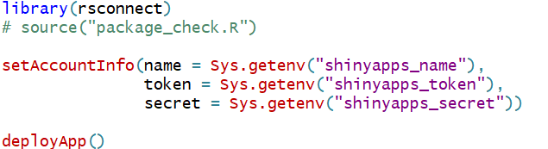

Deploy script (deploy.R)
#4
Doesn’t have to be much more than
Note the commented-out package_check.R file.
These packages are installed based on the YAML config file.
Travis can also be used to perform unit testing while/before deploying.

Slide 25
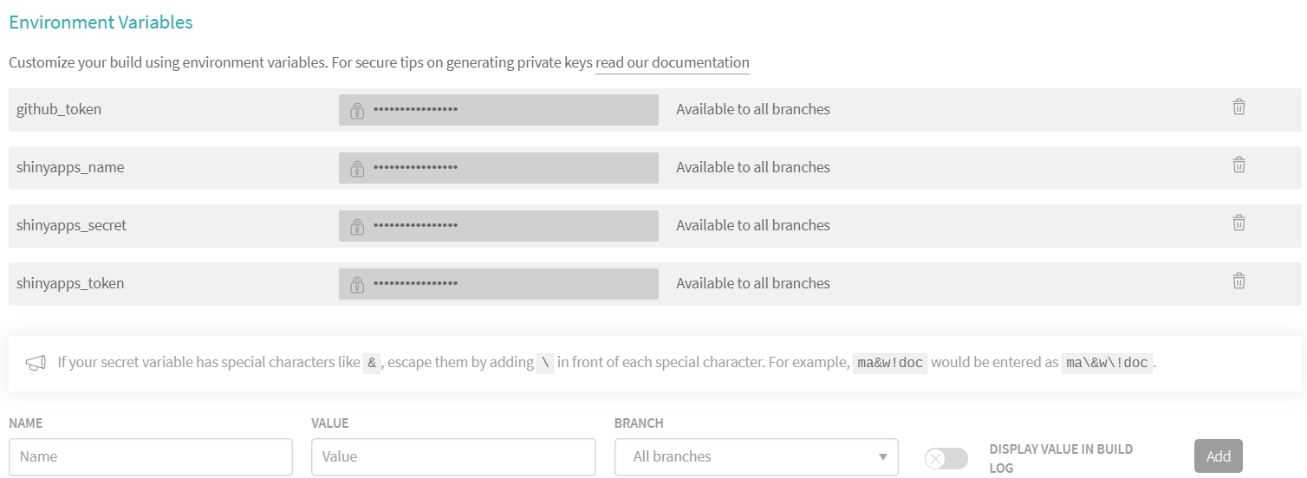
Environmental Variables
#4
You want to keep these private, otherwise anyone can publish anything to your account on shinyapps.io:
Found and editable on Travis CI settings of your repo.

Slide 26

Environmental Variables
#4
You want to keep these private, otherwise anyone can publish anything to your account on shinyapps.io:
Found and editable on Travis CI settings of your repo.
Tokens to add in can are listed here:
https://www.shinyapps.io/admin/#/tokens
(Not shown here for privacy reasons but refer to the previous slide and the deploy script after clicking show and show secret on this webpage.)
After everything is setup and saved, you can git commit and push your code and the Linux container that Travis runs should rebuild, test, and publish the changes you made.
More information at: https://docs.travis-ci.com/user/languages/r/

Slide 27

Questions?
Ask now, or email me at
bohdanmetenko@outlook.com

